Slide 1
MDM EBF:
Emergency Bug Fix
&
RollBack

Slide 2
AGENDA
EBF Pre-Requisit
Configuration
Apply EBF
Rollback EBF

Slide 3
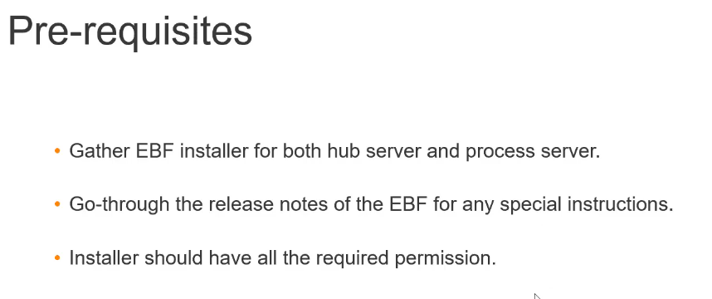
Share MDM Hub Report with GCS
Based on Hub Report – DB, App Server, OS etc GCS will share the EBF
MDM
EBF:

Slide 4
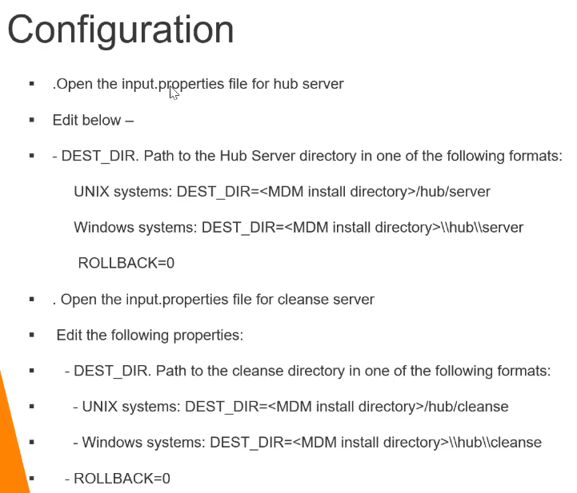
Review the property file and change values accordingly
MDM
EBF:

Slide 5
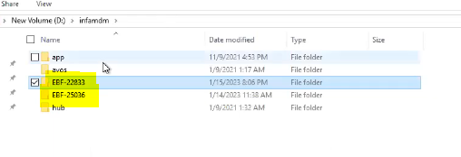
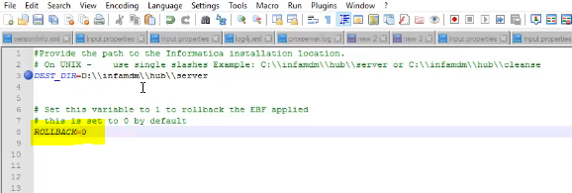
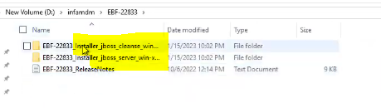
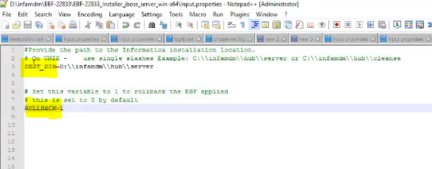
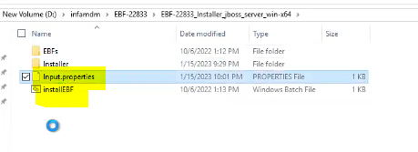
Input.properties file
Same setup do for cleanse EBF
MDM
EBF:
ROLLBACK = 0 to install EBF
EBF for both hub and cleanse server
ROLLBACK = 1 to rollback EBF
Property File and install script

Slide 6
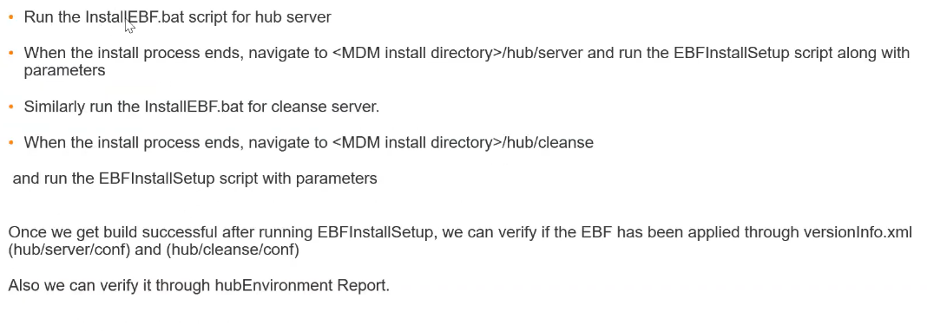
MDM
EBF:

Slide 7
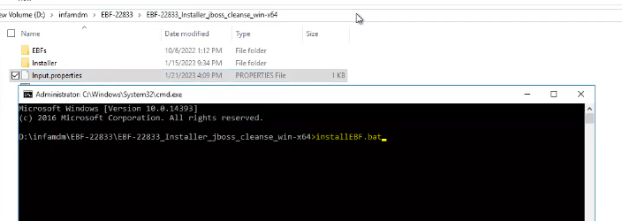
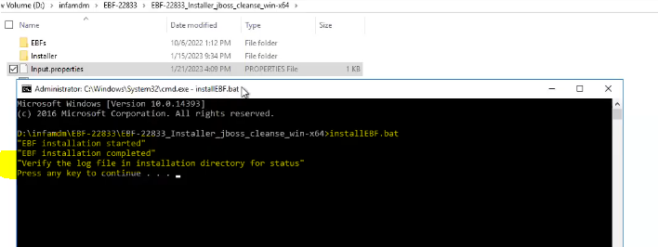
Run Installer for Cleanse Server
MDM
EBF:

Slide 8
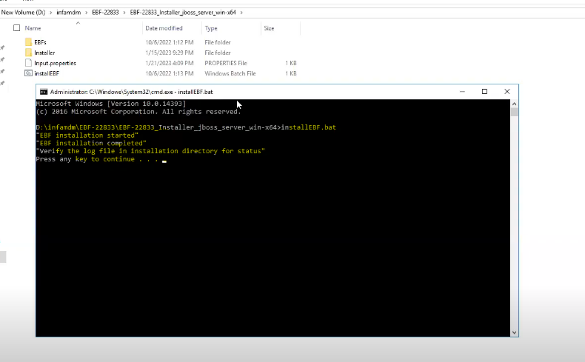
Run EBF Installer for Hub Server
MDM
Automation:

Slide 9
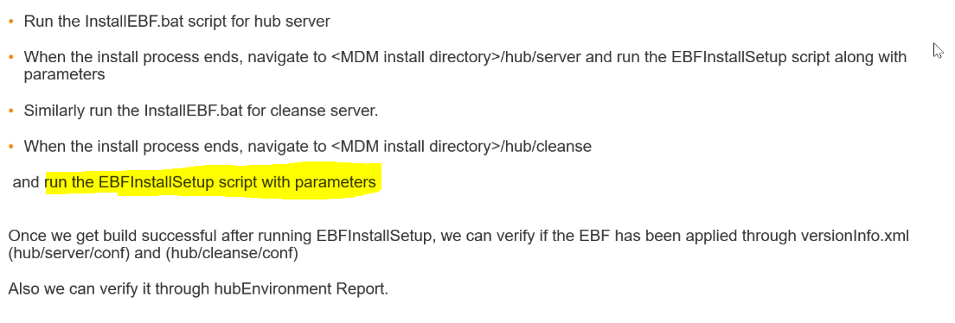
Now Run EBFInstallSetup Script
This will deploy the required changes in hub and cleanse server
MDM
EBF:

Slide 10
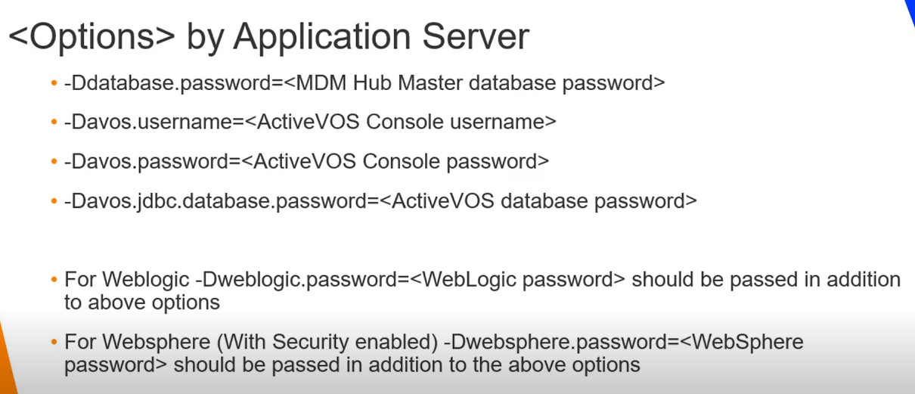
Use Following Parameter to Run EBFInstallerSetup script
MDM
EBF:

Slide 11
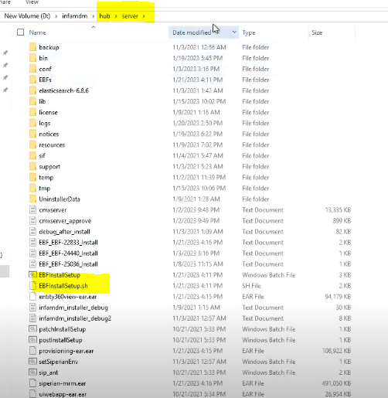
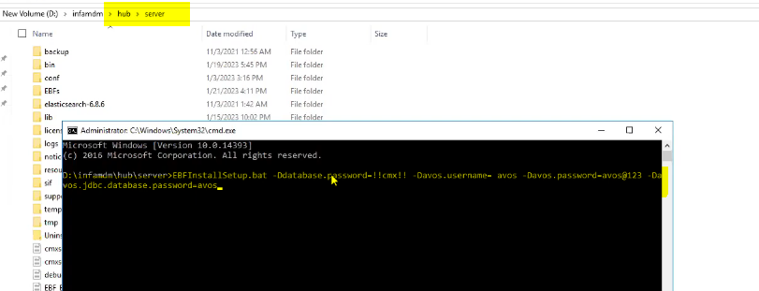
Default Master Schema will be assigned to the user
MDM
EBF:

Slide 12
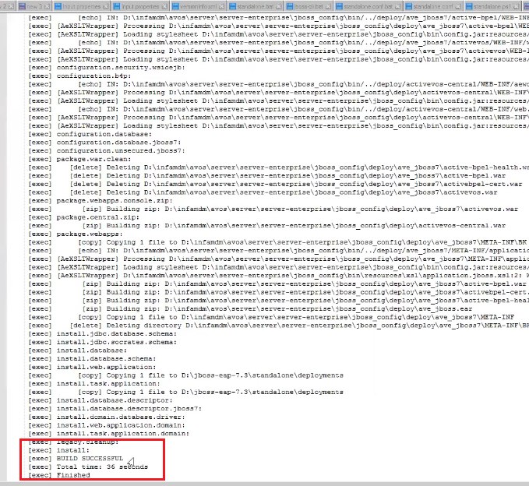
Check Hub → Server → EBFInstallSetup.log file
MDM
EBF:

Slide 13
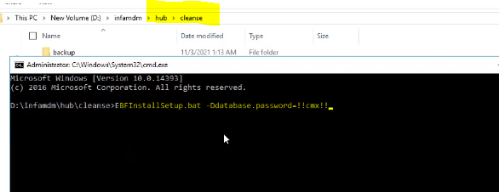
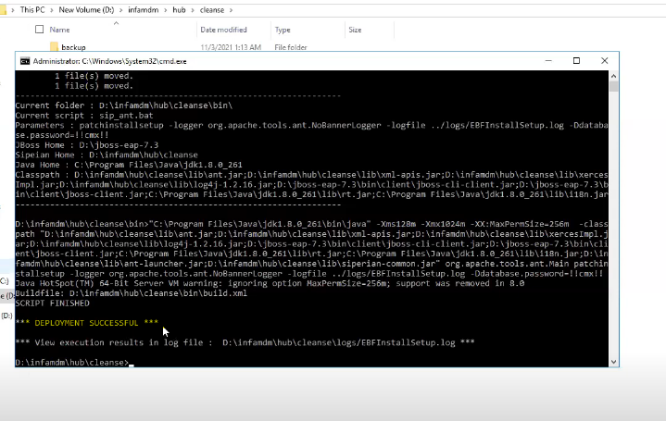
Similarly Run in Cleanse Server
In Cleanse Server just give DB info
You will see deployment is successful and you can check log files
MDM
EBF:

Slide 14
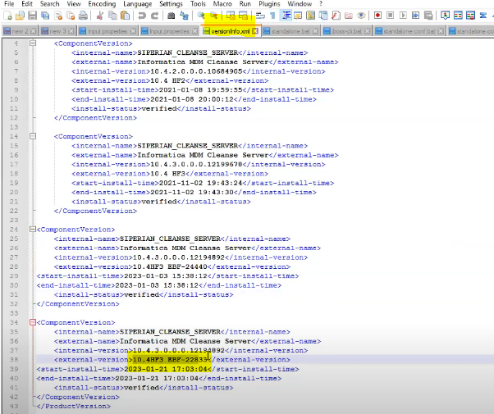
You can Check version info to confirm EBF installation
MDM
EBF:

Slide 15
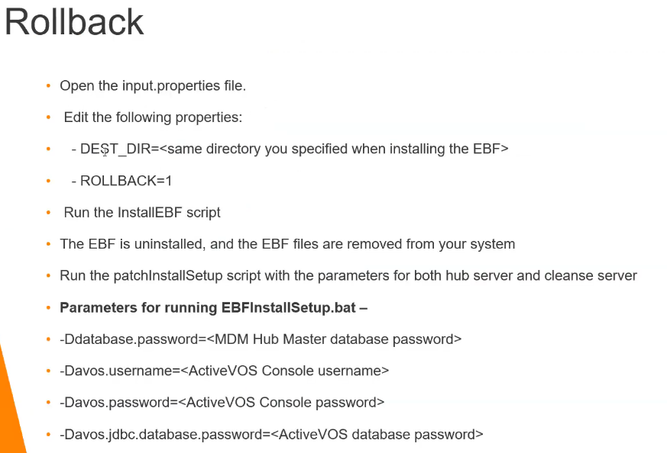
MDM
EBF ROLLBACK:

Slide 16
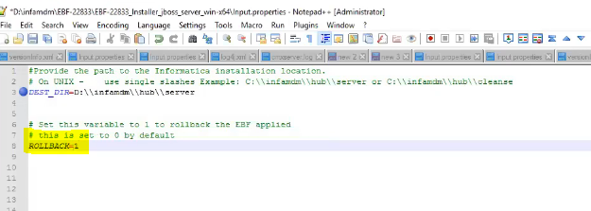
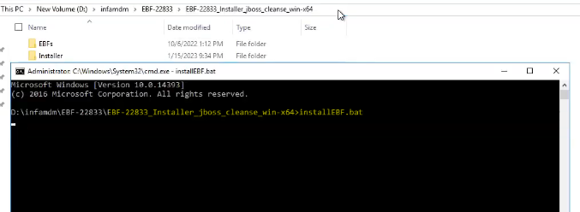
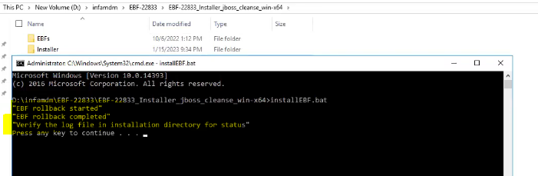
Change RollBack = 1 in input property file in both hub and cleanse
MDM
EBF ROLLBACK:

Slide 17
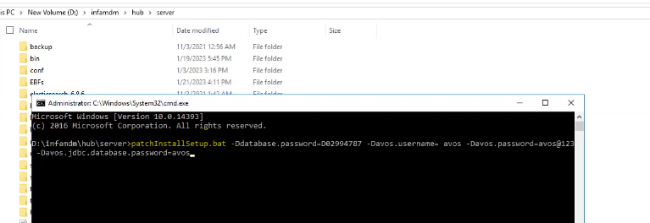
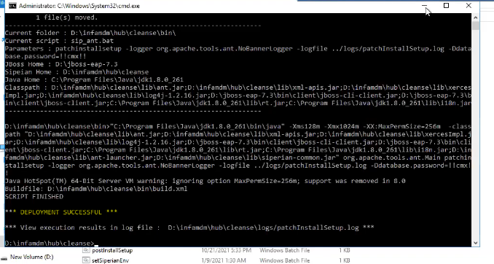
Run patchInstallsetup script to apply the config changes before EBF
Run in both Hub and Cleanse server
MDM
EBF ROLLBACK:

Slide 18
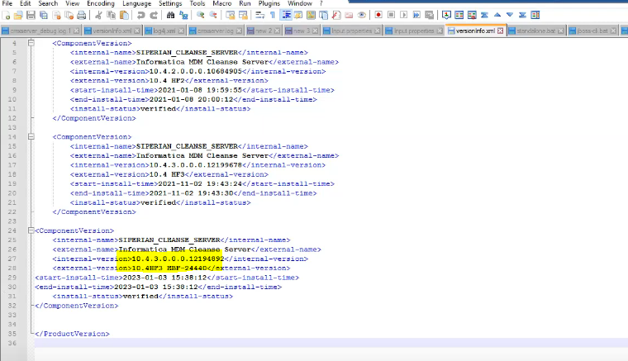
Check in Version info file
Earlier EBF info should have been removed
MDM
EBF ROLLBACK:

